Slide 1
Emotion Classification Using Audio
Exploration of Emotion Recognition using Speech

Slide 2


Contents
01
Dataset
02
Feature Engineering
03
Machine Learning
Deep Learning
04
Source, Preparation, and Descriptive Exploratory Data Analysis
Generate different variations and extracting selective features of speech
Support Vector Machine, Naïve Bayes, K-Nearest Neighbors, Decision Tree, Random Forest
Convolutional Neural Networks

Slide 3
01
Dataset
Dataset consists of different speakers expressing different emotions and these are combined and shuffled to make the final dataset

Slide 4
Dataset
01
CREMA-D
02
RAVDESS
TESS
SAVEE
03
04
Crowd-Sourced Emotional Multimodal Actors Dataset
Ryerson Audio-Visual Database Of Emotional Speech And Song
Toronto Emotional Speech Set
Surrey Audio-Visual Expressed Emotion

Slide 5
CREMA-D (open source)
Number of data points
Number of Emotions
7452
Anger
Disgust
Fear
Happy
Neutral
Sad
Demographics
Male
Female

Slide 6
RAVDESS (open source)
Number of data points
Number of Emotions
1440
Anger
Calm
Disgust
Fear
Happy
Neutral
Sad
Surprise
Demographics
Male
Female

Slide 7
TESS (open source)
Number of data points
Number of Emotions
2800
Anger
Calm
Disgust
Fear
Happy
Neutral
Sad
Surprise
Demographics
Female

Slide 8
SAVEE (open source)
Number of data points
Number of Emotions
480
Anger
Disgust
Fear
Happy
Neutral
Sad
Surprise
Demographics
Male

Slide 9
Final Dataset
Number of data points
Number of Emotions
12172
Anger
Calm
Disgust
Fear
Happy
Neutral
Sad
Surprise
Demographics
Male
Female

Slide 10
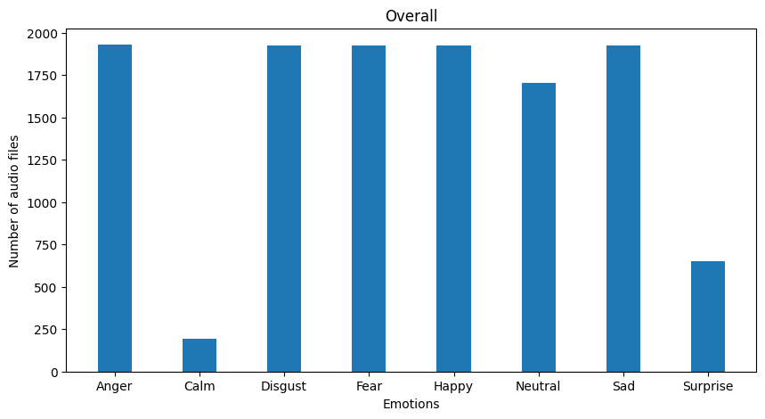
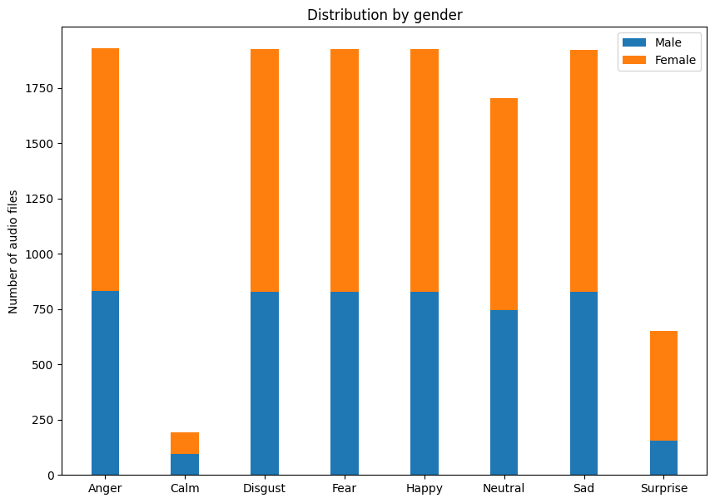
Distribution Of Final Dataset
Data points
By Emotion
Data points
By Demographics

Slide 11
Descriptive Analysis
Average Length of Audio
Range of Audio
5.89 seconds
2.61 seconds
Ideal Length and Range of Audio
Median Length of Audio
2.5 seconds (Ranging from 2.5 seconds to 7.5 seconds)
2.46 seconds

Slide 12
02
Feature Engineering

Slide 13
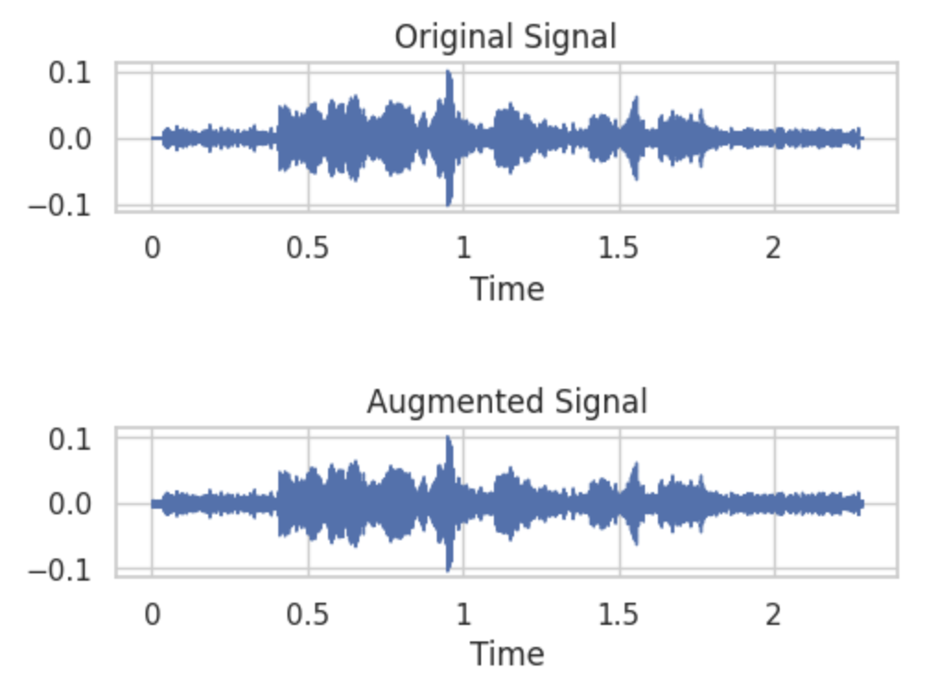

Noise
Randomly adding a small value uniformly across the data
Original
Modified

Slide 14
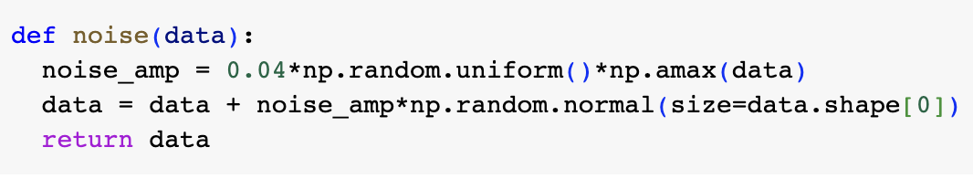
Noise And Its Purpose
Generate a random number as a factor for a randomly generated array and add it to the data (amplitude of the audio file)
Give real world simulation to the model
Create a generalised model

Slide 15
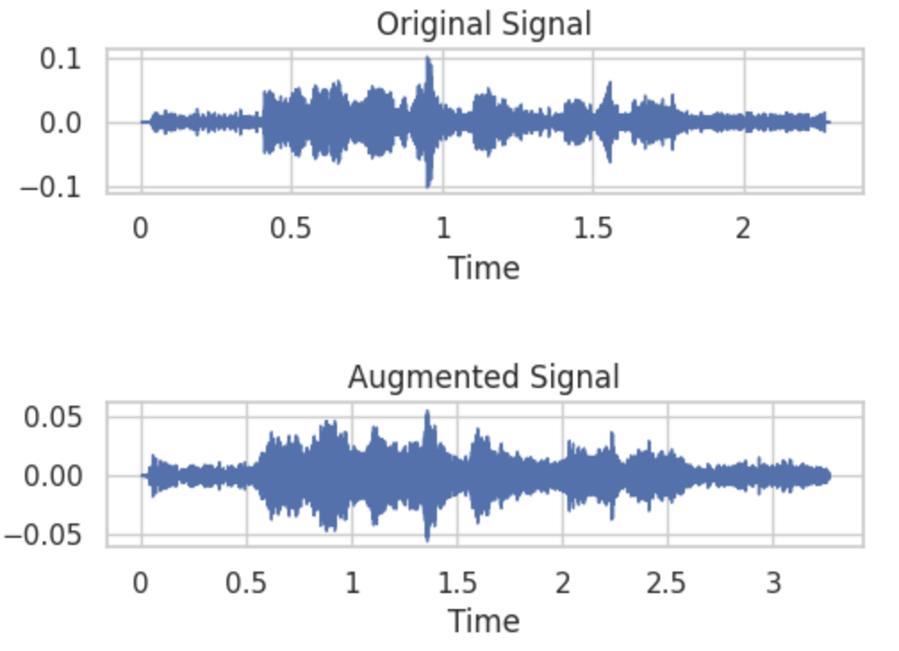
Stretch
Change tempo (beats per minute) of an audio without changing the pitch
Original
Modified

Slide 16
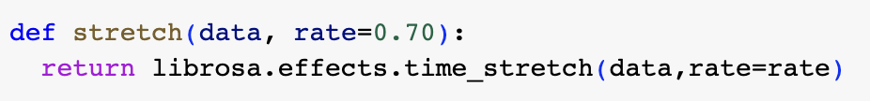
Stretch And Its Purpose
A certain factor with which the audio is time-stretched (increase time between different words)
Real world examples where a speaker might use a pause in between while speaking
Create a generalised model

Slide 17
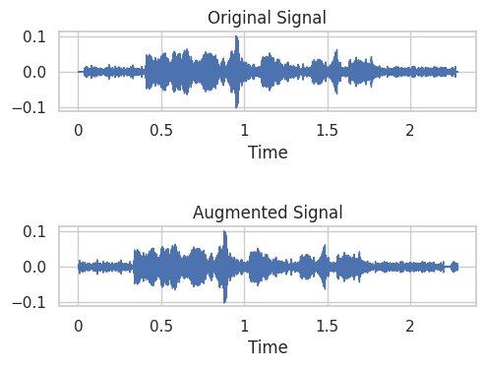
Shift
Create a circular roll in certain set of continuous data values
Original
Modified

Slide 18
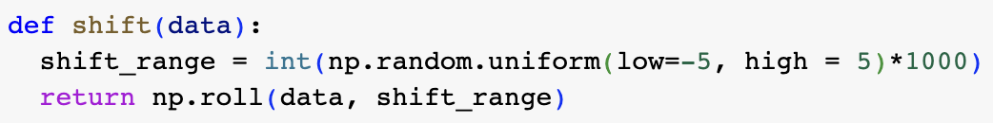
Shift And Its Purpose
Creates a circular shift where different subarrays of data can be shuffled
A possible delay in the recording device can misplace content
Create a generalised model

Slide 19
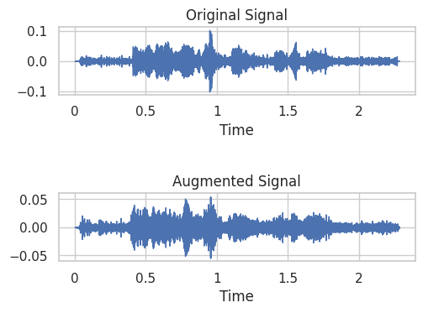
Pitch
Changing the frequency but keeping the same tempo or the duration
Original
Modified

Slide 20
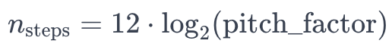
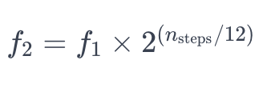
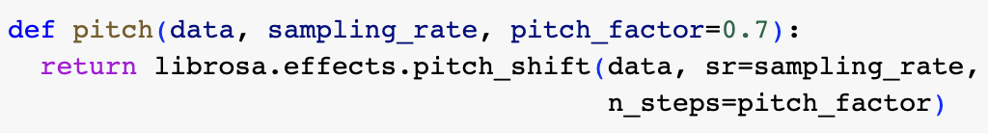
Pitch And Its Purpose
Alter the frequency in the data by changing the number of semitones or number of steps
Handle different demographics (age, ethnicity)
Create a generalised model

Slide 21
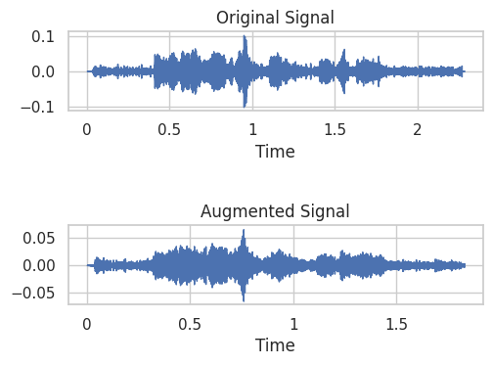
High Speed
An increase in pitch and decrease in tempo or the duration
Original
Modified

Slide 22
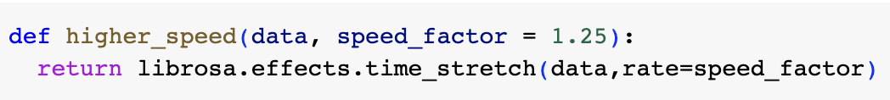
High Speed And Its Purpose
An increase in pitch or increase in semitones and reduce gaps between the sample
Different speeds in voice that naturally occur
Create a generalised model

Slide 23
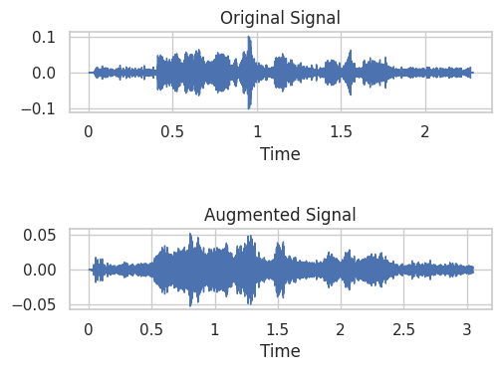
Low Speed
A decrease in pitch and increase in tempo or the duration
Original
Modified

Slide 24
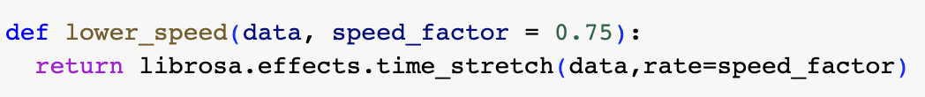
Low Speed And Its Purpose
A decrease in pitch or decrease in semitones and increase gaps between the sample
Different speeds in voice that naturally occur
Create a generalised model

Slide 25
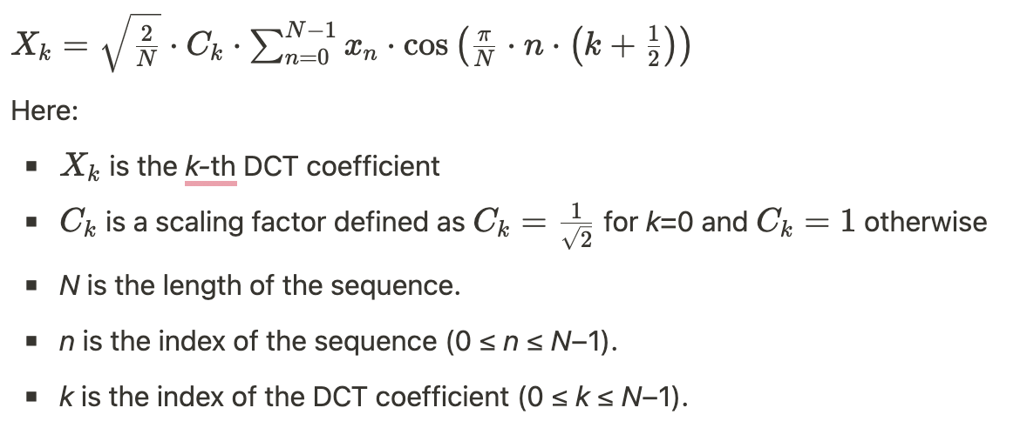
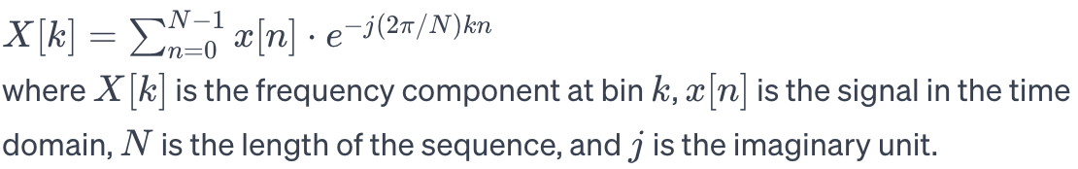
Feature Extraction
Current Data
Changes in Current Data
MFCC
Difficult to differentiate between two audio files by looking at the “Amplitude vs Time” domain graph
Convert to “Amplitude vs Frequency” domain using Fast-Fourier Transform given by
Convert the data to logarithmic scale
Compress data using discrete cosine transform (DCT) and store the coefficients
Mel-frequency cepstral coefficients
Combination of many spectral characteristic values including fundamental frequency, spectral density, spectral flux

Slide 26
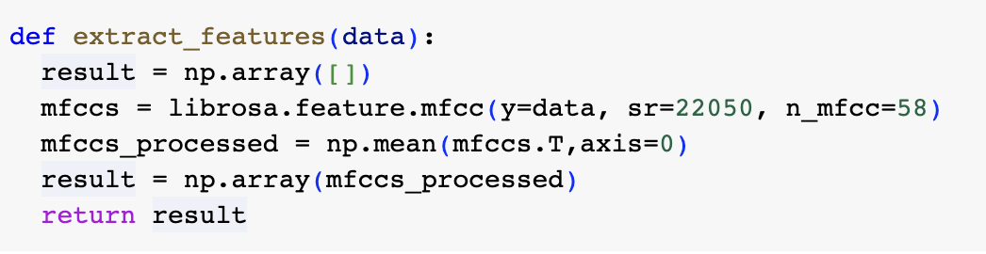
Code to get MFCCs
Audio file modified with the 6 different methods (noise, stretch, shift, pitch, high speed, and low speed)
Each modified output’s MFCCs are extracted and stacked together
Average of the entire MFCCs across the time frames (Final Dimensions are (1, 58)) for a single audio file

Slide 27
03
Machine Learning Models
Support Vector Machine, Naïve Bayes, K Nearest Neighbors, Decision Tree, Random Forest

Slide 28
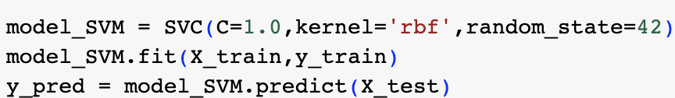
Support Vector Machine
Training Accuracy
Testing Accuracy
Train-Test Split
49.2%
49%
80 : 20

Slide 29
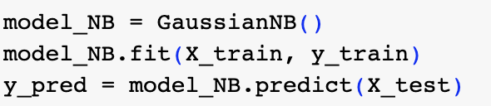
Naïve Bayes
Training Accuracy
Testing Accuracy
Train-Test Split
33%
32.2%
80 : 20

Slide 30
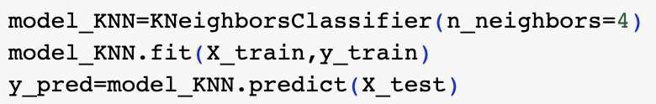
K Nearest Neighbors
Training Accuracy
Testing Accuracy
Train-Test Split
85.2%
70.1%
80 : 20

Slide 31
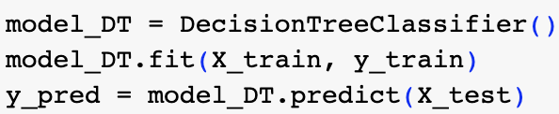
Decision Tree
Training Accuracy
Testing Accuracy
Train-Test Split
98%
77%
80 : 20

Slide 32
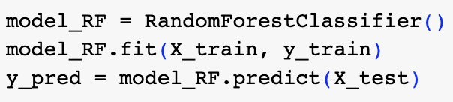
Random Forest
Training Accuracy
Testing Accuracy
Train-Test Split
99%
86%
80 : 20

Slide 33
04
Deep Learning Models
Convolutional Neural Networks

Slide 34
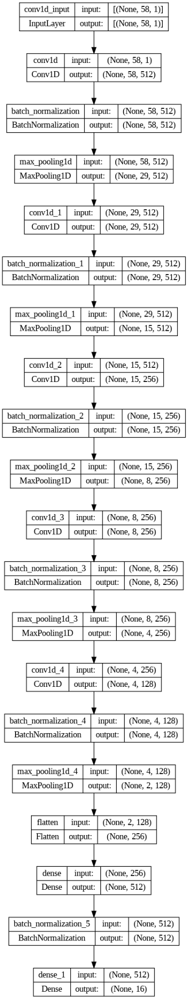
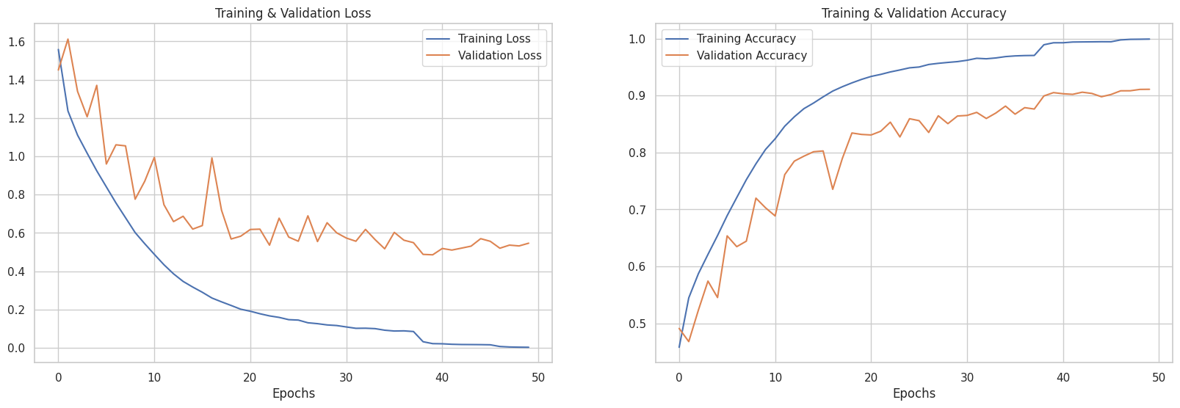
Convolutional Neural Network
Training Accuracy
Validation Accuracy
Train-Test Split
99%
92.4%
80 : 20

Slide 35
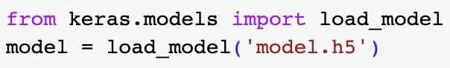
Testing Accuracy
92%
Saving the model in a “.h5” format that can be used further during any implementation

Slide 36
Summary
SVM
49%
NB
32%
Testing Accuracy Comparison
KNN
70%
DT
77%
RF
86%
CNN
92%

Slide 37
What has been done?
Feature Engineering
Deep Learning
Extract MFCCs
SVM, NB, KNN, DT, RF
CNN
Machine Learning

Slide 38
What can be done next?
Ensemble Learning
Feature Engineering
Spectral Centroid, Chroma Features
CNN with LSTM, RNN, NLP
Combination of ML and DL models by using the weightage given to each label by all models
Deep Learning

Slide 39
Resources
Theory and Implementation
PapersWithCode
Open Source (github)
Dataset (Open Source)
RAVDESS
CREMA-D
SAVEE
TESS

Slide 40





Thanks!

